Slide 1

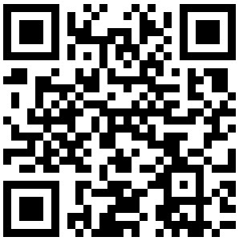
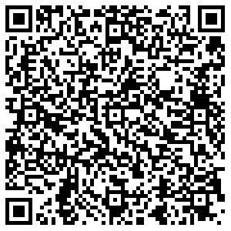
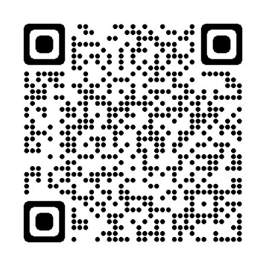
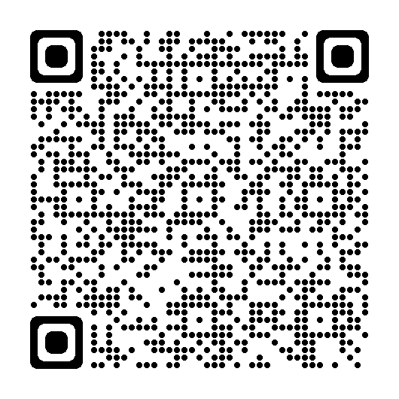
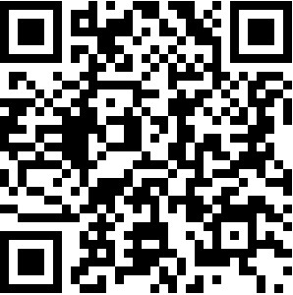

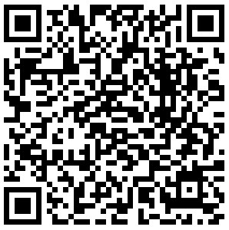
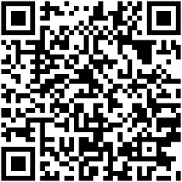
School Readiness & Your Nursery Age Child
Encourage & support your child to develop their independence and be ready for starting school
For Advice and Support with your Child’s Health and Development. The Health Visiting Team can be contacted via a centralised Administration Hub on 020 8973 3490 / email: hrch.hvadminhub@nhs.net
https://www.pacey.org.uk/working-in-childcare/spotlight-on/beingschool-ready
https://www.familylives.org.uk
Generally, your child should be (or nearly) independent going to the toilet
The Health Visiting Service can support and advise on health and development needs such as:
Toilet training, Sleep Routines, Healthy eating advice & General Development
https://eric.org.uk/potty-training
www.nhs.uk/conditions/baby/babys-development/potty-training-and-bedwetting/
https://healthiertogether.hrch.nhs.uk
Children need a healthy, balanced diet to support their development
Supporting your Child’s Health & Wellbeing while at nursery & school:
GP: Your child needs to be registered with a GP.
Opticians: If possible, it is best for you child to have had their first eye test at an opticians before starting Reception Class. Eye tests are free for children at school. Vision Screening is also offered in Reception class.
Dentist: Your child should be registered with a dentist: NHS dentists provide free oral health check-ups and treatment for children under the age of 18.
Vaccinations: As part of the UK childhood vaccinations schedule your child should be offered their “pre-school booster and 2nd MMR” vaccinations. You can book this with the Practice Nurse at your GP surgery.
www.nhs.uk/conditions/baby/weaning-and-feeding/what-to-feed-young-children/
www.nhs.uk/conditions/baby/weaning-and-feeding/fussy-eaters/
3-5 year-olds need 11-13 hours of sleep a night
https://thesleepcharity.org.uk/information-support/children/
Find an NHS dentist: Find more information:
www.dentalchoices.org
www.nhs.uk/live-well/

