Slide 1

Tapestry
Wednesday 2nd October 2019

Slide 2
What is Tapestry?
Tapestry is a secure online Learning Journal that is used to record photos, observations and comments, in line with the Early Years Foundation Stage curriculum, to build up a record of your child’s experiences during their time with us.
Tapestry allows us to work with parents/carers to share information and record the children’s play and learning.

Slide 3
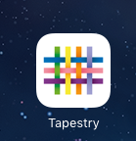
How does Tapestry work?
Each individual child has their own online Learning Journal.
As Parents/Carers you have provided the office with an email address which we will use to activate your account. You will receive an email asking you to set a password.
Staff are given a secure login.

Slide 4
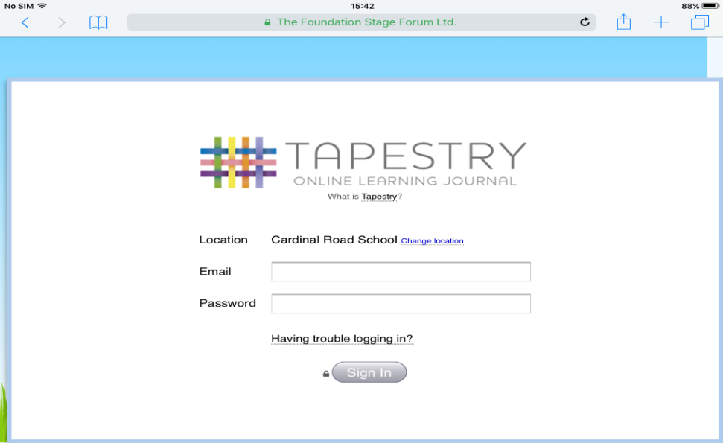
Where do I start?
Once your account has been activated you can access Tapestry on your computer.
https://eylj.org/
Login using your email address and the password you created.

Slide 5
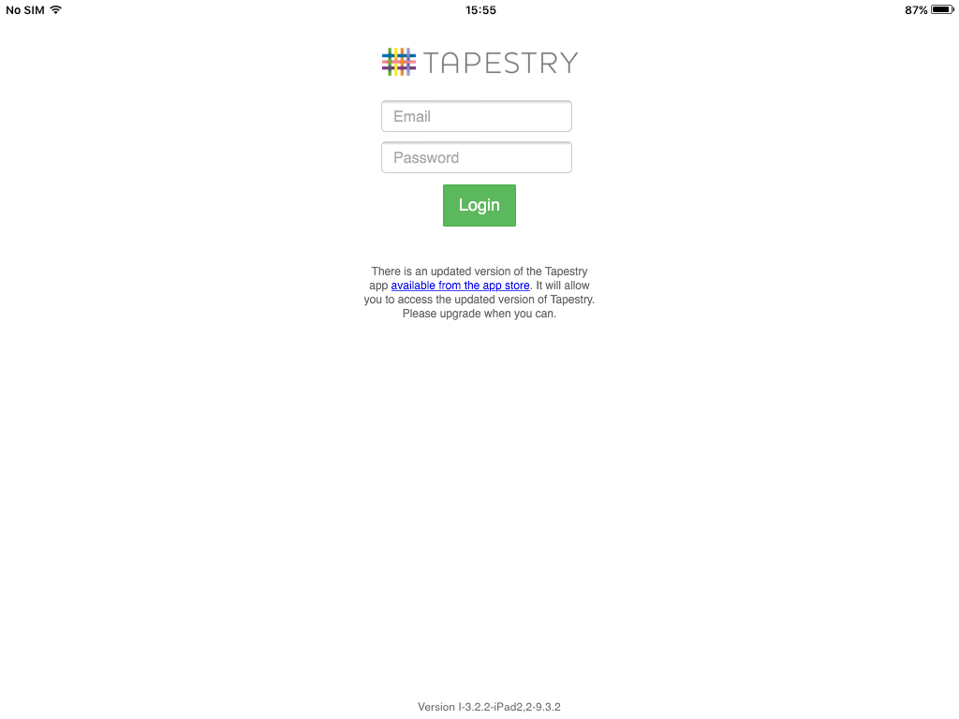
I phone or I Pad – Please visit the I Tunes store and download the Tapestry app.
Android Phone/Tablet – Search for the Tapestry Learning Journal and download.

Slide 6
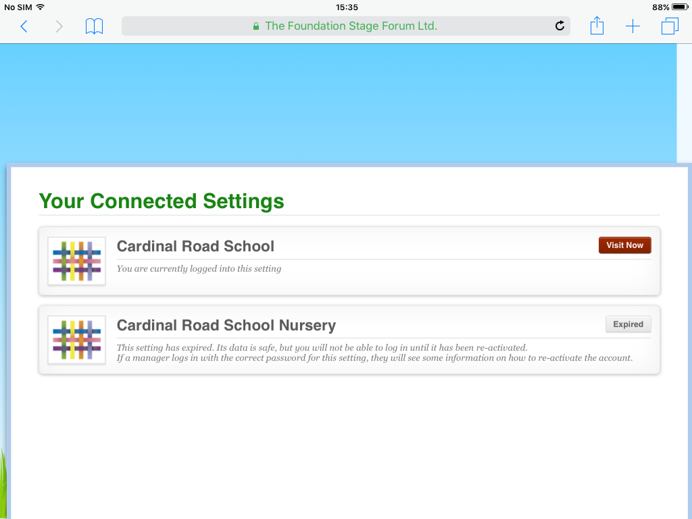
Who can access Tapestry?
Parents/Carers can both access Tapestry by providing us with email addresses.
You can choose to share your log in details with extended family so that they can see your child’s Learning Journal.

Slide 7
How can I view my child’s Learning Journal?
Once you login you will see your child’s observations on your home screen.
Observations are displayed in a list format and if you select one of the observations it will open for you to look at it.
You may add comments in the box at the bottom of the observation if you wish. We love to receive such comments.

Slide 8
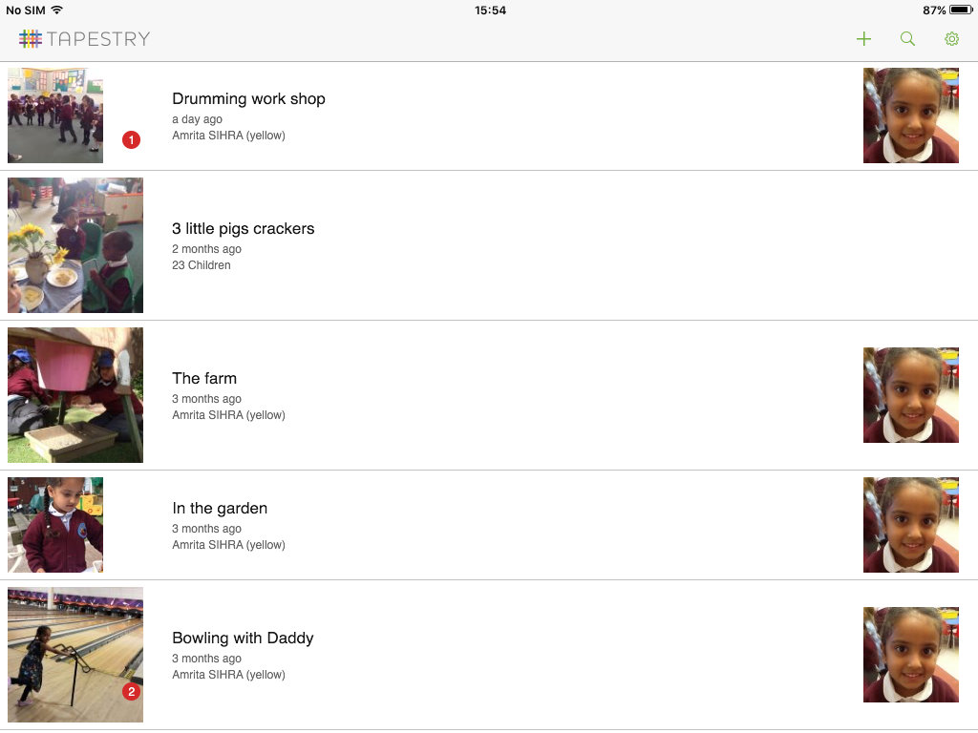

Slide 9
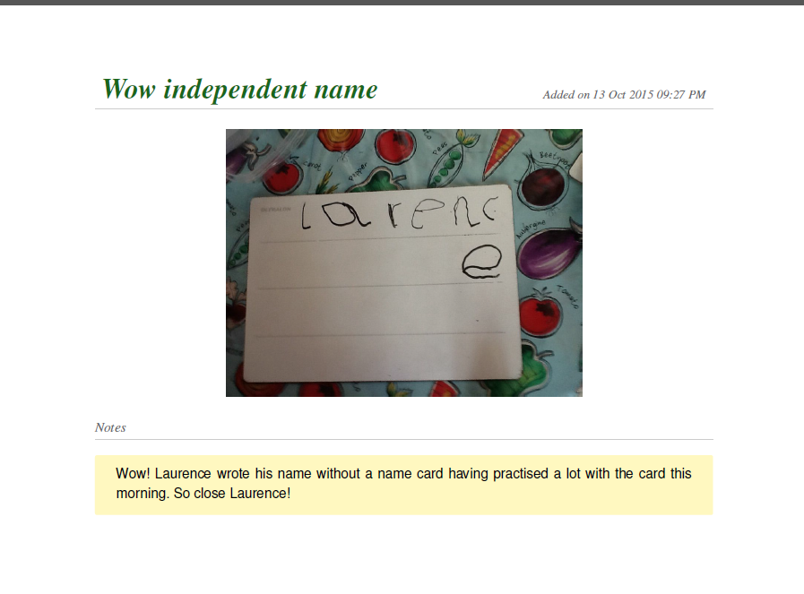
What can you do?
Check weekly for any staff uploads, detailing any new learning experiences.

Slide 10
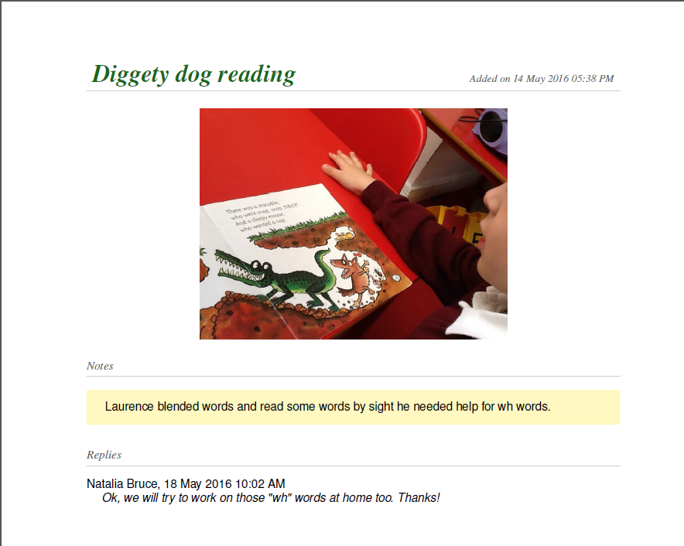
Respond to the teacher’s suggestions/ask questions.

Slide 11
Share ‘Wow’ moments of learning that happen outside school. Please explain why you have uploaded a photo and tell us what your child said and did. Observations containing ‘child speak’ are very informative.
Not just ‘nice’ photos!

Slide 12
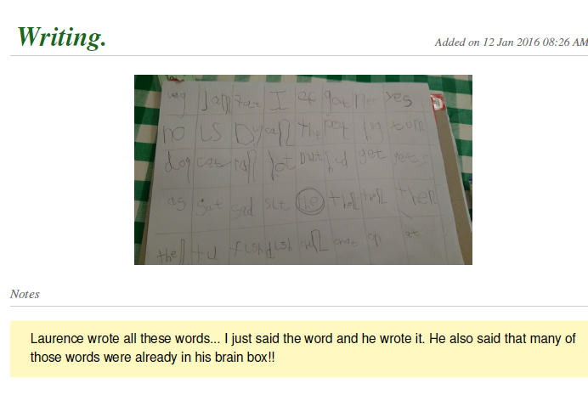

Slide 13
Please be aware that there will often be other children in photos/video observations of your child. Please do not share these on social media.
If you have any difficulty accessing Tapestry please speak to us and we will do our best to help you.
Thank you for coming.

